Slide 1
Lesson 0.2
Data Science Quickstart!
Cornell University
Systems Engineering
Dr. Tim Fraser
Assistant Teaching Professor

Slide 2


Summary
Date
01
02
03
04
git bash
Your IDE
Dependencies
Github
🐍
⚙️
🆁

Slide 3
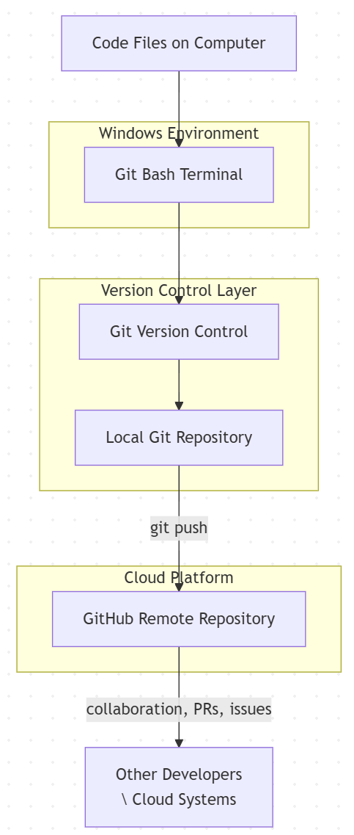
🌐What is Git Bash?
Date
🧑‍💻 Command-line terminal for Windows
🗓️ Origins: Built on Git (2005, Linus Torvalds) to bring Linux tools to Windows
🌍 Value-Added: Free, open-source tool that works on Macs, Linux, & PCs
⚙️ Uses: Used to run git version control commands, but also start processes, jobs, manage files, and run command line software (eg. gcloud).
📦Git vs. Git Bash: Git is a program for version control. Git Bash is a terminal. Git gets run in Git bash.
🌐Further Reading
Learn more with the Git Pro Book
Download Git & Git Bash here
Notes:
Image source: https://www.altexsoft.com/media/2021/03/rest_api_works.png

Slide 4
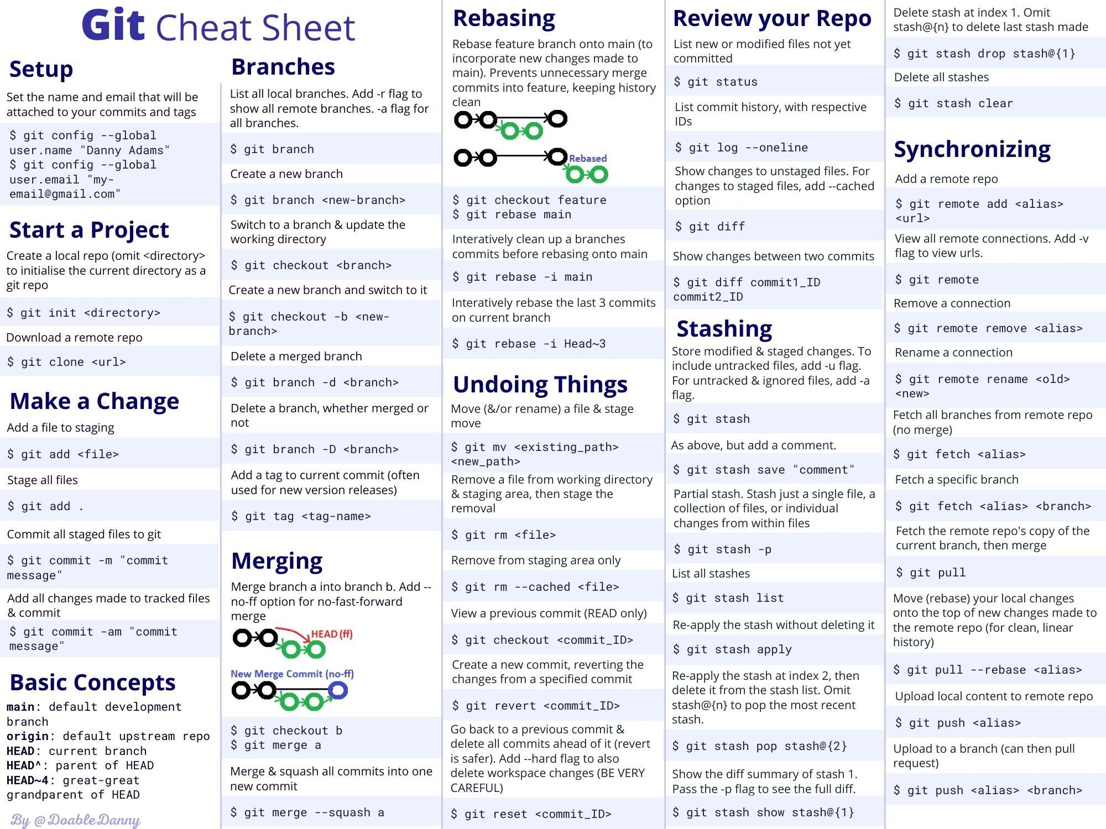
🌐What is
Git Bash?
Date
Git Version Control CheatSheet
Credit: Danny Adams, Web Developer & Education Content Creator
Notes:
Image source: https://www.altexsoft.com/media/2021/03/rest_api_works.png

Slide 5
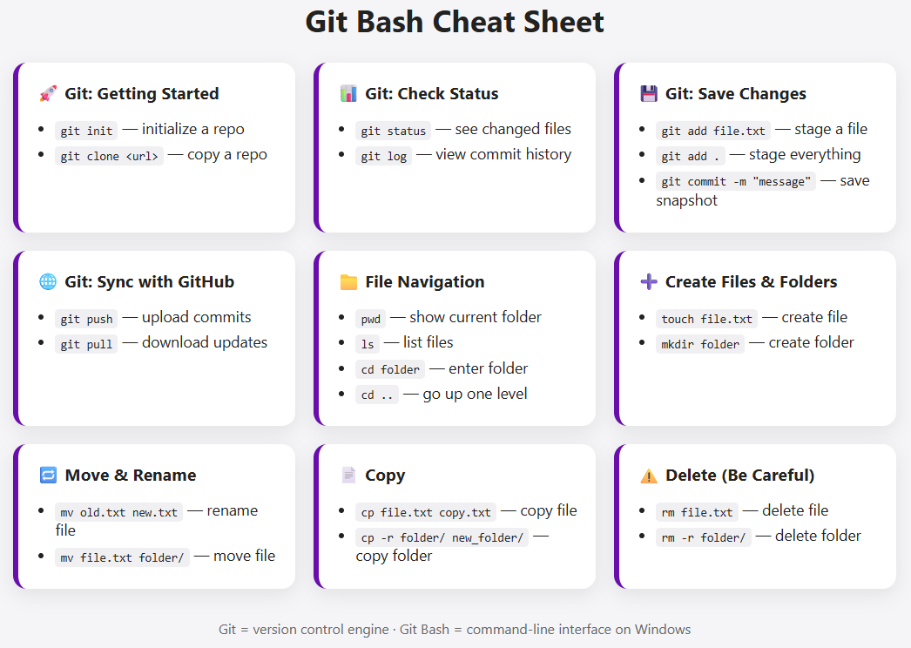
🌐What is
Git Bash?
Date
Git Bash
CheatSheet
Credit: Tim & GPT
Pro Tip:
Make .html cheatsheets for yourself with AI!
Notes:
Image source: https://www.altexsoft.com/media/2021/03/rest_api_works.png

Slide 6
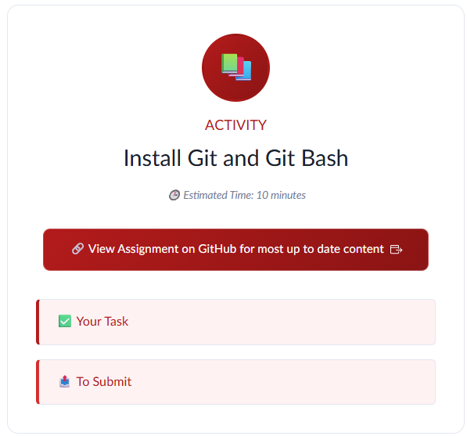
🌐ACTIVITY
📦Install Git and Git Bash!
Remember to submit evidence (screenshot) on CANVAS!
github.com/timothyfraser/dsai/blob/main/00_quickstart/ACTIVITY_git.md
Notes:
Image source: https://www.altexsoft.com/media/2021/03/rest_api_works.png

Slide 7



🌐What is an IDE?
Date
🧑‍💻 Integrated Development Environment - a graphical user interface for coding!
📦Most today based off VSCode
🔌Supports Python, R, Git Bash, and many others, and more plugins.
READ: FastCompany’s profile of the Cursor IDE (just ~2 years old)
Notes:
Image source: https://www.altexsoft.com/media/2021/03/rest_api_works.png

Slide 8
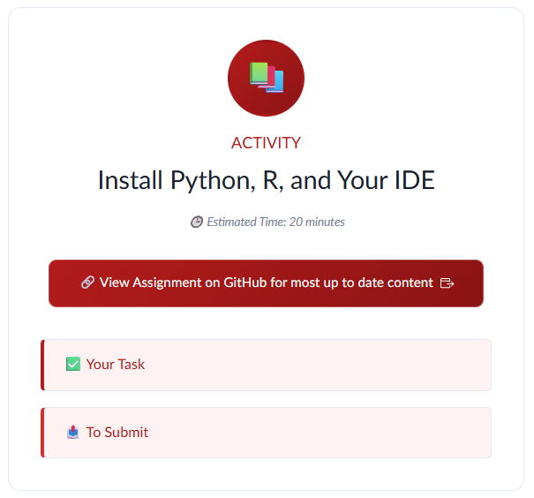
🌐ACTIVITY
📦Install Python, R, & your IDE!
Remember to submit evidence (screenshot) on CANVAS!
github.com/timothyfraser/dsai/blob/main/00_quickstart/ACTIVITY_software.md
Notes:
Image source: https://www.altexsoft.com/media/2021/03/rest_api_works.png

Slide 9
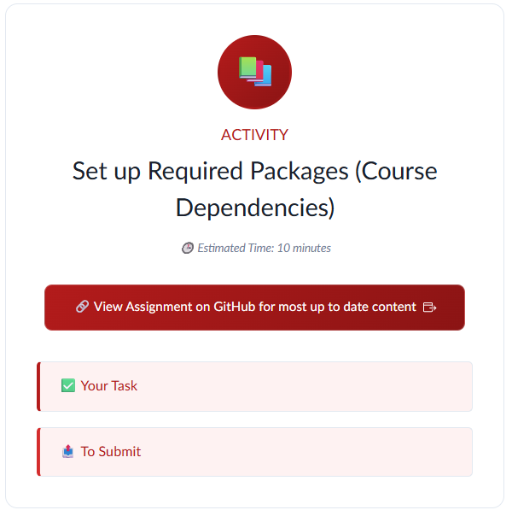
🌐ACTIVITY
📦Set up Required Packages (Course Dependencies)
Goal - load settings with a .bashrc file (or add to PATH)
Remember to submit evidence (screenshot) on CANVAS!
github.com/timothyfraser/dsai/blob/main/00_quickstart/ACTIVITY_dependencies.md
Notes:
Image source: https://www.altexsoft.com/media/2021/03/rest_api_works.png

Slide 10
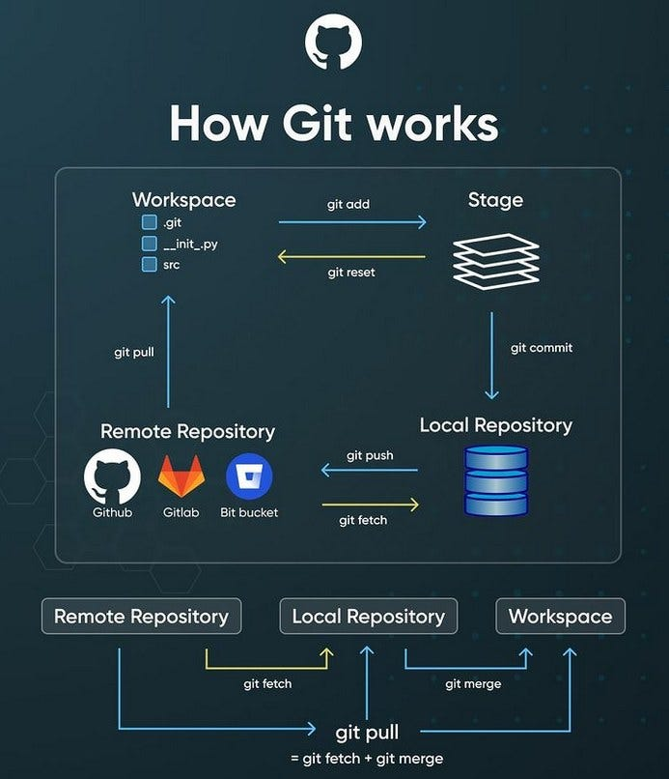
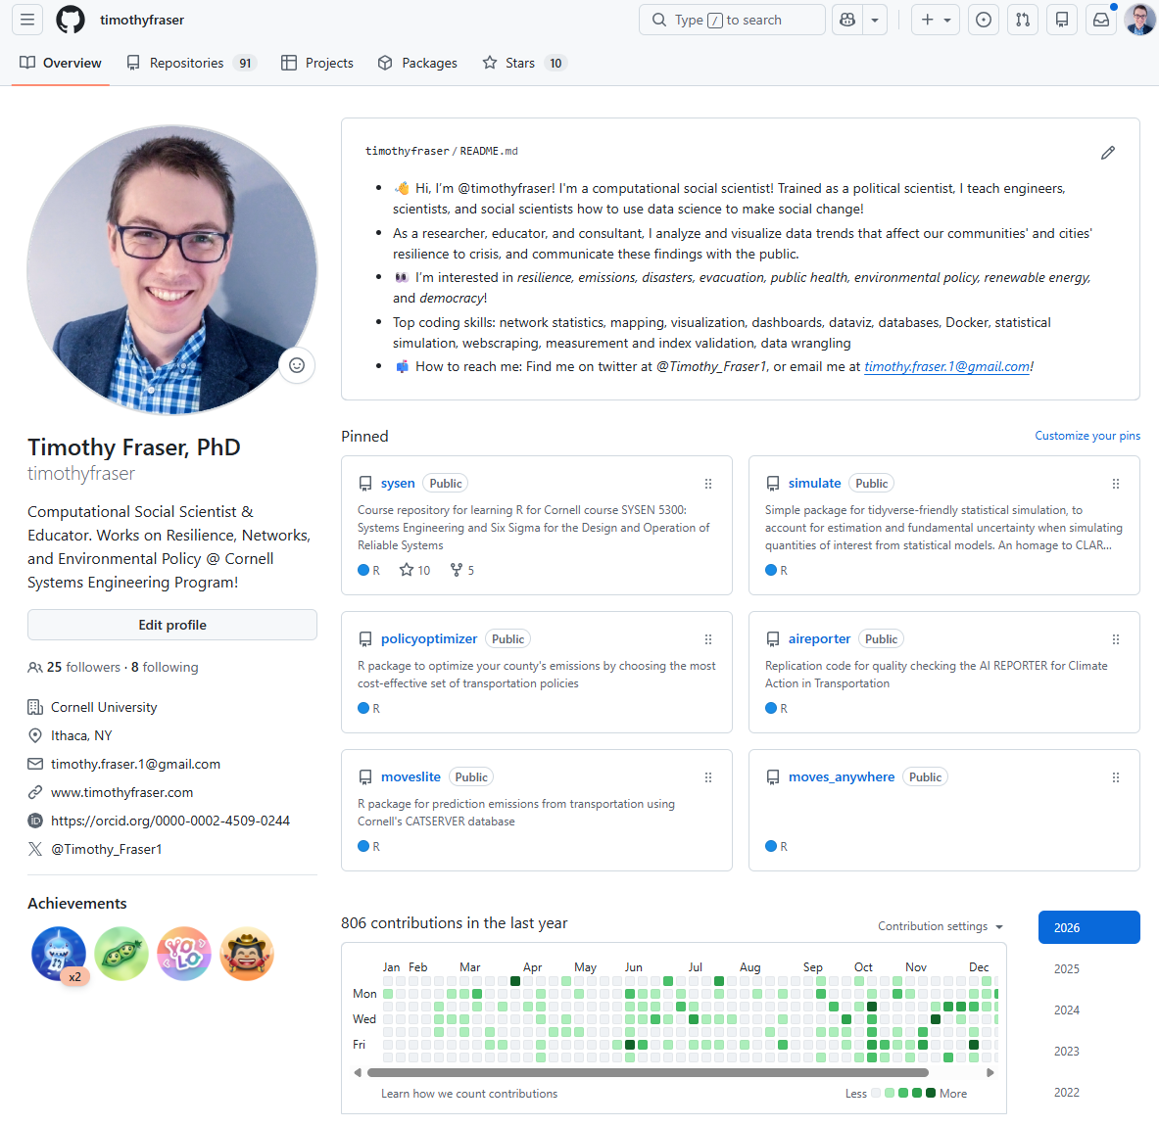
🌐What is Github?
🗓️ Origins: GitHub founded in 2008, acquired by Microsoft in 2018.
🧠 Function: Hosts Git repositories (“repos”) for version control, backups, and collaborative development.
🤝 Collaboration: Enables issues, code review, and project management for distributed teams.
🌍 Value-added: Core infrastructure for modern software, data science, and open science workflows.
Notes:
Image source: https://www.altexsoft.com/media/2021/03/rest_api_works.png

Slide 11
🌐What is Github?
🗓️ Profiles: GitHub also acts as a kind of profile for modern developers.
Developers often host their personal websites, etc. using them.
Tips:
Use your actual name (or something memorable) for your github id.
Update your full name on github to make you more easily searchable.
Feel free to use my profile as a template. Eg.
github.com/timothyfraser
github.com/timothyfraser/cv
timothyfraser.github.io
Notes:
Image source: https://www.altexsoft.com/media/2021/03/rest_api_works.png

Slide 12
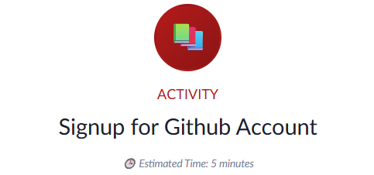
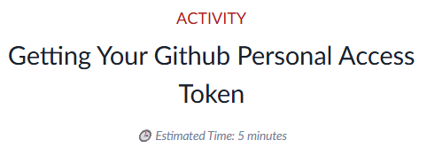
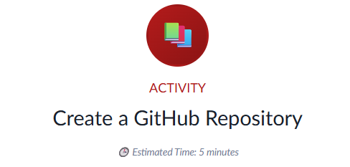
🌐ACTIVITY
📦Set up and use Github!
Remember to submit evidence (screenshot) on CANVAS!
00_quickstart/ACTIVITY_github_setup.md
00_quickstart/ACTIVITY_github_pat.md
00_quickstart/ACTIVITY_github_repo.md
Notes:
Image source: https://www.altexsoft.com/media/2021/03/rest_api_works.png

Slide 13
Happy coding!

